Slide 1
Energy-Efficient Cloud Computing
Aditya Desai
PC15, Trimester IX
Guide: Prof. Rajendra G. Pawar

Slide 2


1. Introduction
Cloud computing is a computing standard that delivers on demand a highly manageable, robust and flexible platform for various distributed computing applications through a set of geographically separate data centers. [2]
The data centers have expanded exponentially and along with that their power consumption. The energy consumption leads to high operating costs and great environmental impacts.
As a result, significant research has been conducted on how to reduce the power consumption of data centers

Slide 3
2. Motivation/Need
Electricity demand for data centers is expected to increase by more than 66 percent over the period 2011–2035 [4].
An idle server has been estimated to use about 70 percent of its peak capacity.
In its latest report, Amazon estimated that their data centers consumed up to 52 per cent of the cloud system's overall energy and pushed the cloud maintenance expense to 42 per cent [2]
Owing to the drastic effect of energy consumption on the scalability of data centers, businesses are focused on energy efficiency

Slide 4
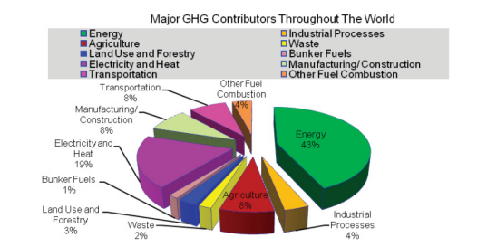

Slide 5
Literature
Survey

Slide 6
What is it.
Servers, communications network, and the cooling system are the major sources of power consumption in a datacenter.
Given the perpetual evolution of heterogeneous on-demand requests and the huge need of an elastic cloud, the so-called green or sustainable cloud computing has been getting a lot of interest in recent years.
This seminar presentation will work to cover a few methods that can lead to Energy-Efficient Cloud Computing.

Slide 7
In the previous review, we talked about two methods for attaining energy efficiency.
Virtual Resources Management
Container Resources Management .
Now I will talk about the other methods that will be included in the report.

Slide 8
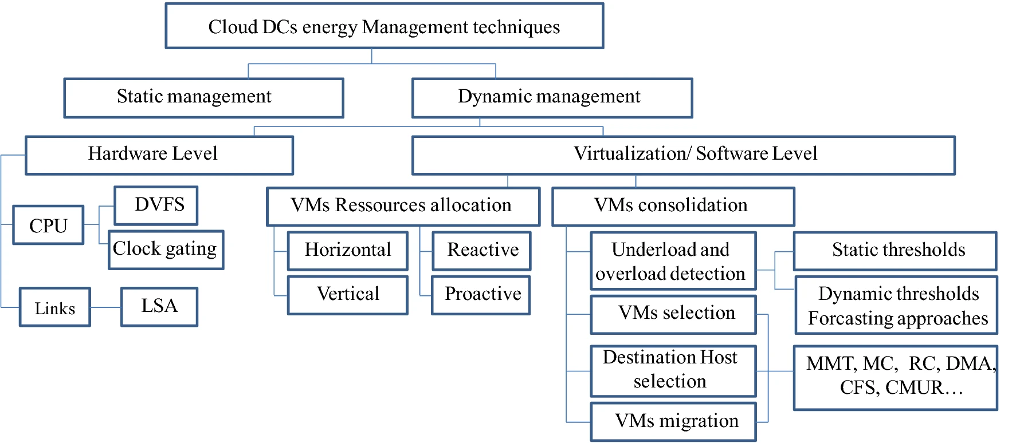
Virtual Resources Management

Slide 9
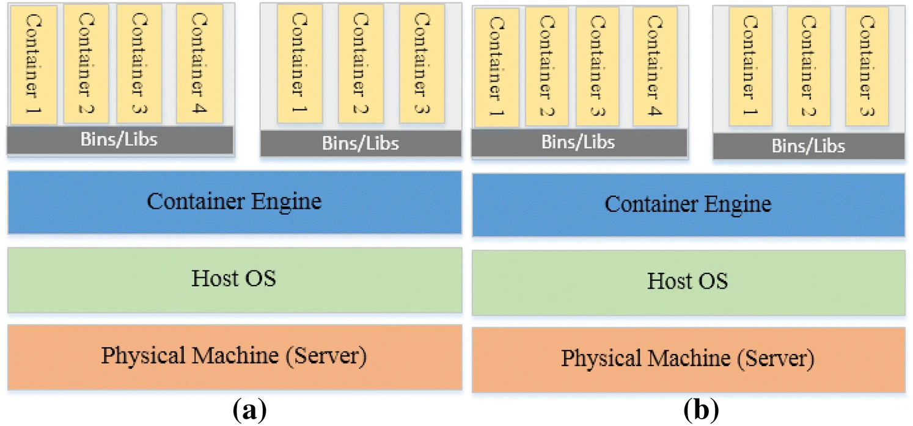
Container Resources Management

Slide 10
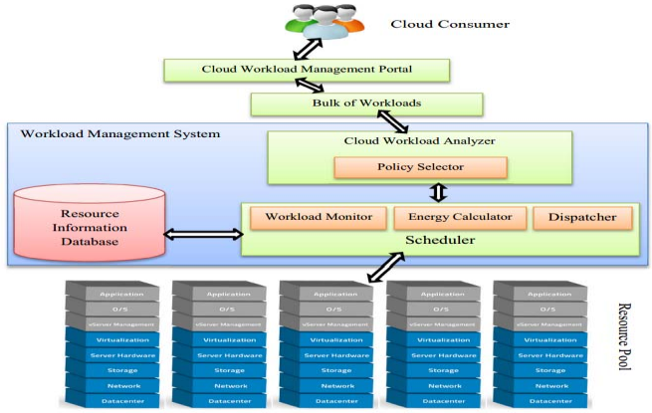
Dynamic and Energy Efficient Greedy Scheduling Algorithm [2]
This section proposes an energy-aware, preemptive task scheduling algorithm. The algorithm assigns the tasks to appropriate V.M which is able to allocate CPU, memory, storage, S.L.A requirements of the task, able to withstand temperature rise due to execution of the task, and left with a maximum energy residue
On receiving the task to be scheduled, task scheduler (the proposed algorithm) will check for the active virtual machine to assign the task. The selection criteria are as follows:
Criteria 1: Must able to allocate CPU, memory, storage requirements of the task and able to withstand temperature rise due to execution of the task and on allocation of the task.
Criteria 2: Must complete the task (waiting time + processing time) within the required S.L.A.
Criteria 3: If more than one virtual machine satisfies the above criteria, scheduler opts for the V.M, whose remaining CPU, memory, storage and temperature capacities are maximum after the execution of the task

Slide 11
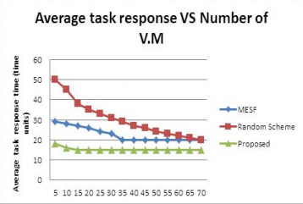
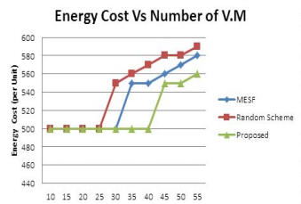
Dynamic and Energy Efficient Greedy Scheduling Algorithm [2]
If no active V.M is able to allocate the required resources are not able to complete the task within the required S.L.A, the scheduler will spawn a new V.M with the required resources and add it to the active V.M queue.
If a V.M reached its threshold level, to maximize the energy efficiency, we are preempting the task and allocating it to another V.M which is currently active. If none of the V.M accommodates the task, then we are spawning a new V.M.
Numerical experiments were simulated using widely accepted CloudSim tool, to verify the effectiveness of the proposed algorithm in minimizing energy consumption in task scheduling

Slide 12
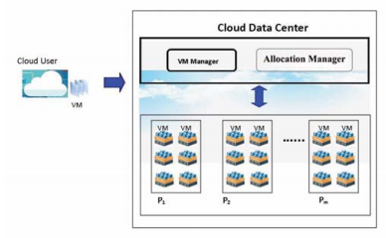
Efficient Resource Management for Virtual Machine Allocation [5]
In this resource management system model, the concept of a bin-packing problem is applied and VM allocation can be optimized with the Best-fit (BF) scheme. This paper considers the CPU and Memory demand of VM to allocate on the active PMs. The proposed VM placement algorithm will optimize the utilization of physical servers and faster response mapping the VM to the servers in the data center.
In this model, VM manager collects and store the user requested incoming VMs in the virtual machine list at a regular time interval and waits for allocation in the list. This manager sorts VMs and PMs in decreasing order for allocation manager.
The allocation manager gets the first VM from the VMs list and allocates on the most suitable PM by deploying the proposed efficient VM allocation algorithm

Slide 13
Efficient Resource Management for Virtual Machine Allocation [5]
The main idea is that we need to find an algorithm for choosing the most suitable PM effectively and efficiently.
The proposed allocation algorithm will be significantly faster than the existing allocation while mapping the VM to best suitable PM by deploying the binary search method which was used in the past.
Its complexity is O(log n) and it is much faster than the sequential search one in the normally used algorithms. The more PM exists in the model, we would obtain faster and better result in mapping.

Slide 14
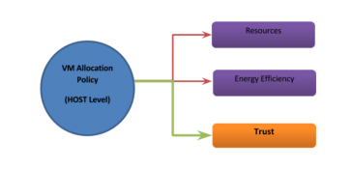
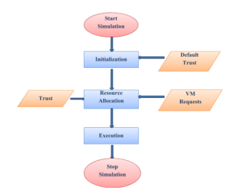
Secure VM Allocation in Untrusted Environment [9]
Given the importance of virtualization layer, it has attracted attackers in the past. Several attacks on virtualization layer are well known and investigated by researchers like Distributed Denial of Service (DDoS) attack, VM Sprawl, Co-resident attacks, etc
This work focuses on performing energy efficient VM allocation in presence of untrusted cloud computing environment. More specifically, we take into consideration insider threat scenario whereby an insider is able to compromise some of the host machines (HMs) inside the data center (DC) of cloud computing environment.
It includes:
Introduction of the notion of trust in cloud computing environments by associating a trust metric with each host machine in cloud data center.
A novel VM allocation algorithm is proposed that is energy efficient and at the same time takes into consideration trust factor.
Evaluate proposed algorithm on various types of loads simulated using CloudSim toolkit

Slide 15
Secure VM Allocation in Untrusted Environment [9]
Trust refers to believe, confidence and reliance on something or someone. Trust may be considered as a belief that one party has on another party based on its behavior, past experiences (Direct) and/or on recommendation from any trusted third party (Indirect).
In this work, before allocating a VM to any host machine or before migrating VM from one host machine to another, trust of host machine is evaluated. If the host is trustworthy, then allocation and migration takes place, otherwise, another host machine is selected.
Suppose, host machine A wants to migrate VM to another host machine B. Before migration A will calculate trust degree of B by requesting recommendation from trusted third party,
T (HostA,HostB) = T (HostB) ×T (HostA,DataCenter)
where T (HostA,HostB) = Trust value of host machine B calculated by host machine A. T (HostB) = Trust value of host machine as recommended by Datacenter (TTP). T (HostA,DataCenter) = Trust value of datacenter w.r.t host machine A( assumed to be 1)
Trust of each host in DataCenter is being periodically calculated based on two factors: SLA violation per host and fault occurrence at host

Slide 16
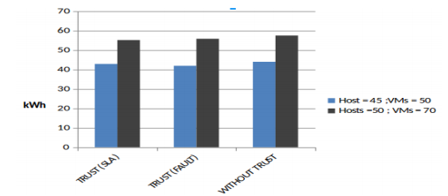
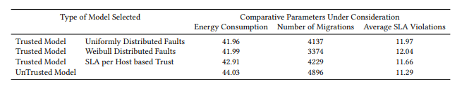
Secure VM Allocation in Untrusted Environment [9]

Slide 17
Temporal load aware resource allocation[4]
Optimization of power in a datacenter is a difficult problem because of server resource constraints, network topology and bandwidth constraints, cost of VM migration, the heterogeneity of workloads and the servers. The arrival of new jobs and departure of completed jobs also create workload heterogeneity in time. As a result, most of the previous research has concentrated on partial optimization of power consumption, which optimizes either server and/or network power consumption through placement of VMs.
Temporal load aware optimization, minimization of power consumption as a function of time has vastly been studied. When optimization also included migration, then solution had been divided into two steps, in the first step optimization of server and/or network power consumption is performed and in the second step migration of VMs has been taken care of
In this work, [4] has developed joint optimization of power consumption of servers, network communications and cost of migration with workload and server heterogeneity subject to resource and bandwidth constraints through VM placement. Optimization results in an integer quadratic program (IQP) with linear/quadratic constraints in number of VMs assigned to a job on a server.
[4] haa obtained numerical results for optimal power consumption for the system as well as its power consumption due to two heuristic VM assignment algorithms. The results show optimization achieves significant power savings compared to the heuristic algorithms

Slide 18
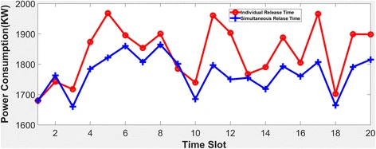
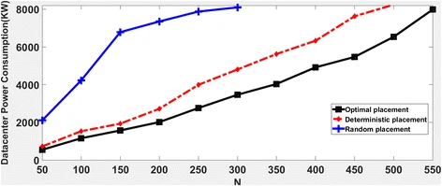
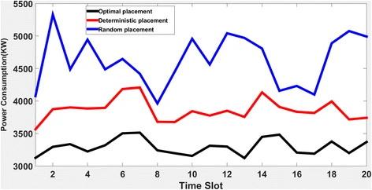
Temporal load aware resource allocation[4]

Slide 19
Some other Energy-aware Scheduling algorithms [6]
Best‑effort scheduling (MIN–MAX) In this scheduling, only one objective is focused upon without considering other objectives such as QoS factors, e.g., considering time as the only constraint without focusing on cost/energy or only energy-aware scheduling without focusing on QoS (minimizing SLA violations).
QoS‑constrained Workfow scheduling This type of scheduling is more used in actual applications. There is always a trade-of; if one tries to minimize certain factor, other automatically increases. Therefore, to handle the trade-of, it is done. The aim is to optimize one parameter while applying the constraint to another parameter. The goal is to generate a schedule in accordance with the preferable parameter meeting specifed QoS constraints
Multi‑criteria Workfow scheduling In this type of scheduling, many parameters are considered simultaneously which confict often. It could be QoS constrained even. VM consolidation was performed using prediction algorithms. Novel multi-criteria techniques were employed for selection of overloaded hosts and appropriate VMs. Results showed 98.11% reduction in a metric composed of migrations, violations in SLA, and consumption of energy

Slide 20
Future Scope
A complete optimization of resources usage through an energy-efficient virtual resources allocation management is not only restricted to computing resources, but also is expected to extend beyond local and backbone network resources. [1]
Enhance the performance of the trust based model by improving the evaluation of trust degree of each host by considering more factors beyond SLA violations and faults. Along with this, different behavior of insider attackers can be considered. [9]
One of the open challenges that still affecting cloud’s energy efficiency and elasticity is the inter- and intra-migration of virtual resources, where only very little research has succeeded in removing them entirely. [1]

Slide 21
Conclusion.
Thus, in this paper I intend to brief you about the various algorithms presented by researchers for improving energy efficiency in the field of Cloud Computing.
There are many more methods available for more different scenarios and can be utilized as per your current situation, to obtain optimal performance

Slide 22
References
Hamzaoui, I., Duthil, B., Courboulay, V. et al. A Survey on the Current Challenges of Energy-Efficient Cloud Resources Management. SN COMPUT. SCI. 1, 73 (2020)
M. Sarvabhatla, S. Konda, C. S. Vorugunti and M. M. N. Babu, "A Dynamic and Energy Efficient Greedy Scheduling Algorithm for Cloud Data Centers," 2017 IEEE International Conference on Cloud Computing in Emerging Markets (CCEM), Bangalore, 2017, pp. 47-52, doi: 10.1109/CCEM.2017.9
Y. Zong et al., "Location-aware energy efficient virtual network embedding in software-defined optical data center networks," in IEEE/OSA Journal of Optical Communications and Networking, vol. 10, no. 7, pp. 58-70, July 2018, doi: 10.1364/JOCN.10.000B58
Vakilinia, S. Energy efficient temporal load aware resource allocation in cloud computing datacenters. J Cloud Comp 7, 2 (2018)
K. M. Nwe, M. K. Oo and M. M. Htay, "Efficient Resource Management for Virtual Machine Allocation in Cloud Data Centers," 2018 IEEE 7th Global Conference on Consumer Electronics (GCCE), Nara, 2018, pp. 419-420, doi: 10.1109/GCCE.2018.8574804

Slide 23
References
Khattar, N., Sidhu, J. & Singh, J. Toward energy-efficient cloud computing: a survey of dynamic power management and heuristics-based optimization techniques. J Supercomput 75, 4750–4810 (2019)
Tarandeep Kaur and Inderveer Chana. 2015. Energy efficiency techniques in cloud computing: A survey and taxonomy. ACM Comput. Surv. 48, 2, Article 22 (October 2015), 46 pages
Sukhpal Singh Gill and Rajkumar Buyya. 2018. A Taxonomy and Future Directions for Sustainable Cloud Computing: 360 Degree View. ACM Comput. Surv. 51, 5, Article 104 (December 2018), 33 pages
Swati Sharma and Rishabh Kaushal. 2017. Energy Conserving Secure VM Allocation in Untrusted Cloud Computing Environment. In Proceedings of the 10th Annual ACM COMPUTE Conference, India (ACM COMPUTE 2017). ACM, New York, NY, USA, 9 pages
Deafallah Alsadie, Zahir Tari, Eidah J. Alzahrani, and Albert Y. Zomaya. 2018. Dynamic resource allocation for an energy efficient VM architecture for cloud computing. In Proceedings of the Australasian Computer Science Week Multiconference (ACSW ’18). Association for Computing Machinery, New York, NY, USA, Article 16, 1–8

